Slide 1
ML for Lower Back Pain Symptoms Dataset
Parissa Amin
amin.Parissa@gmail.com

Slide 2
Content
Clean and data visualize
Compare normal vs abnormal to get intuition
Select appropriate ML and run it
Analyze ML using SHAPLEY values
Does ML work properly?
Suggestions

Slide 3
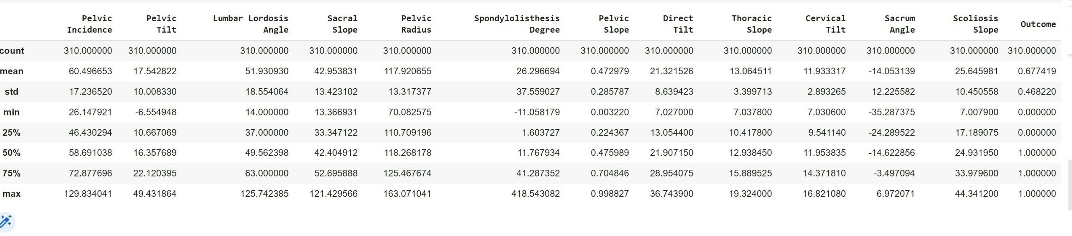
Data Description

Slide 4
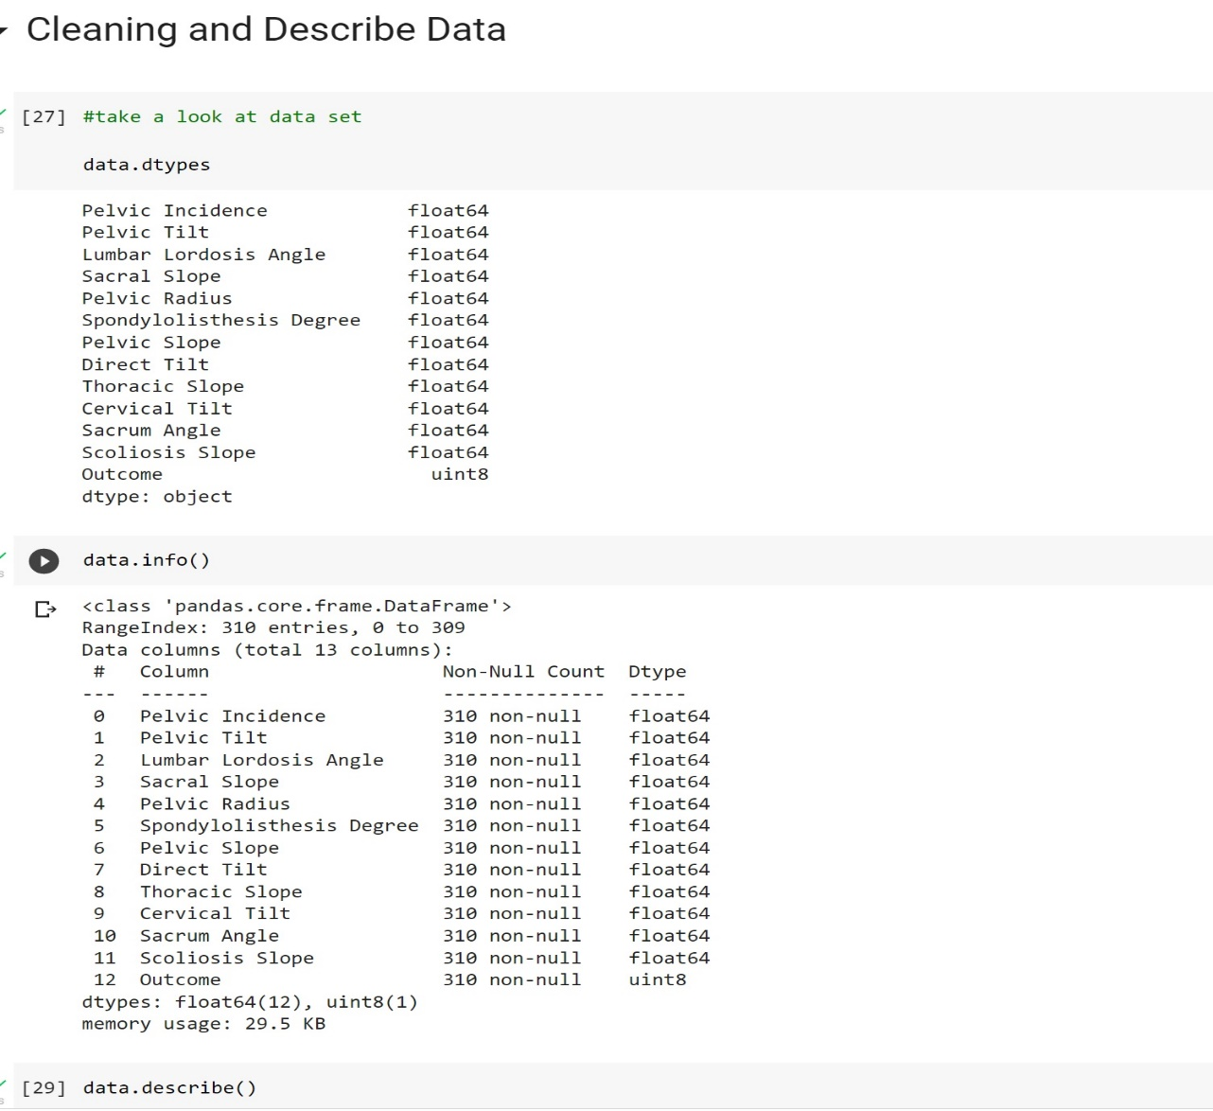
Data Cleaning

Slide 5
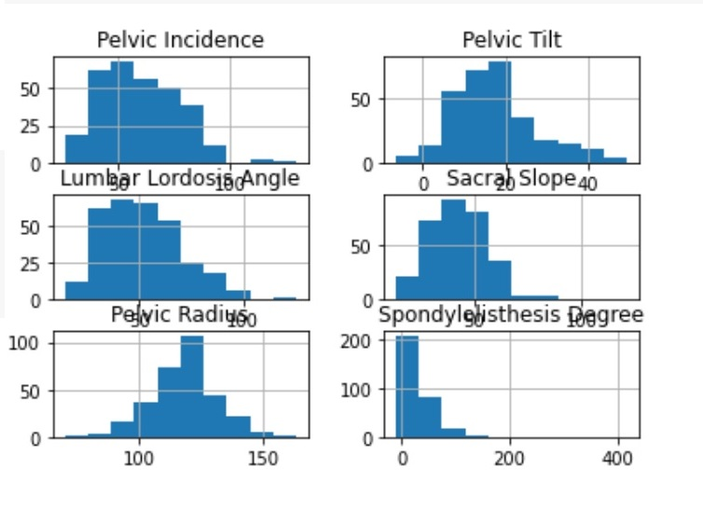
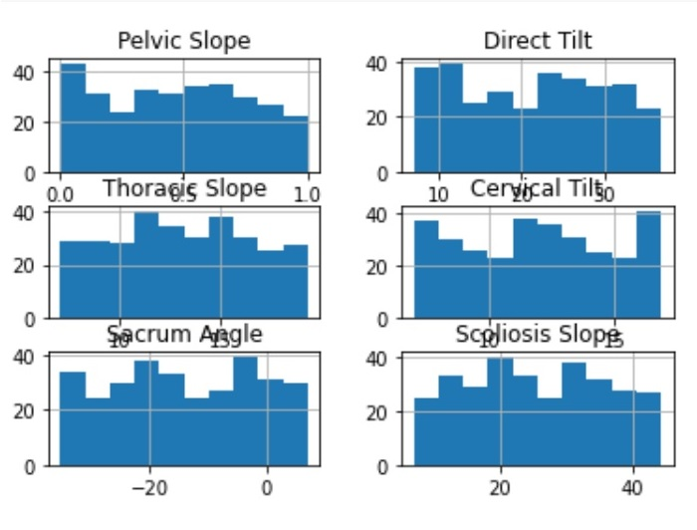
Data Visualization

Slide 6
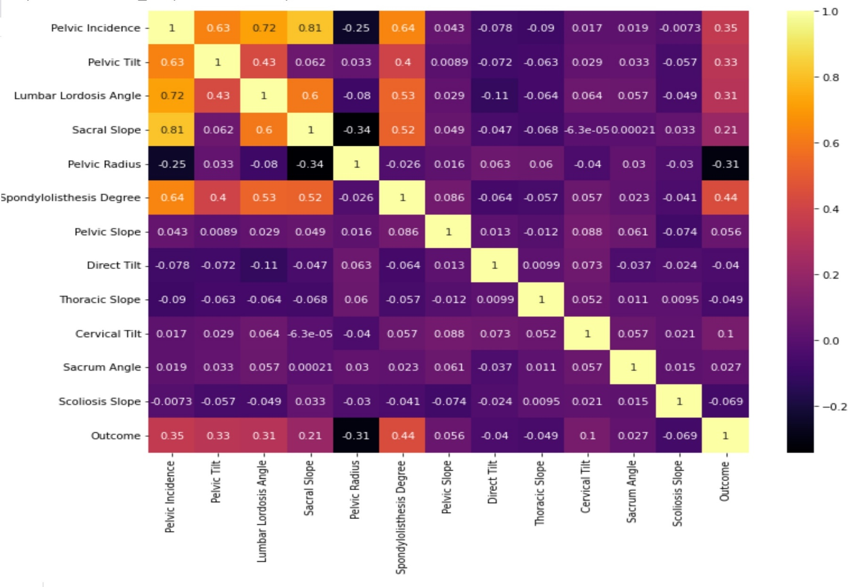
Heat Map

Slide 7
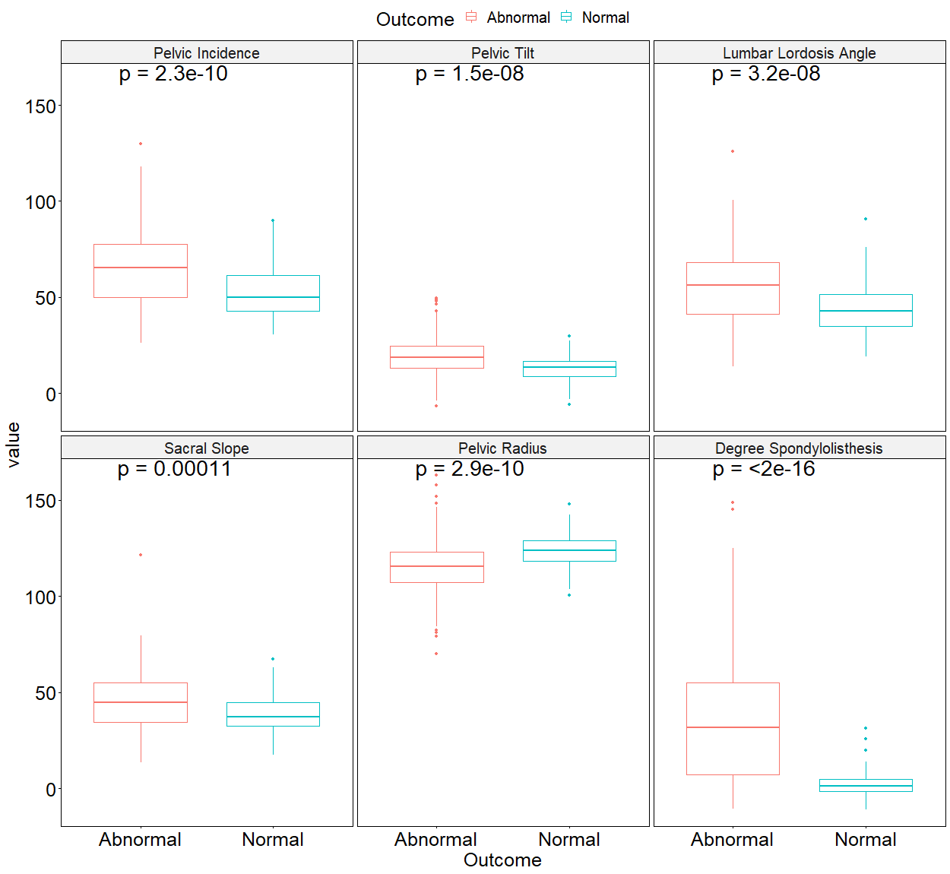
Normal vs Abnormal

Slide 8
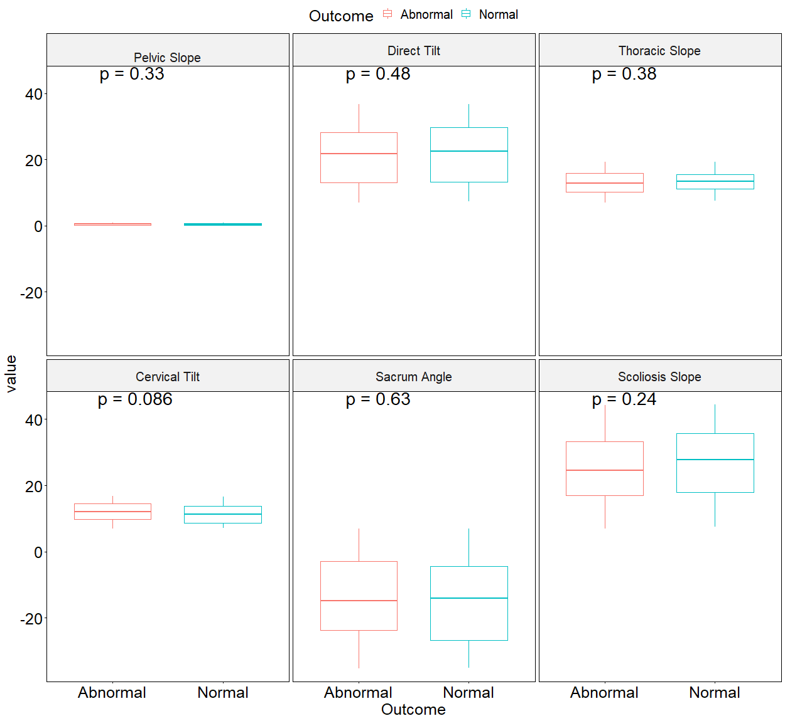
Normal vs Abnormal

Slide 9
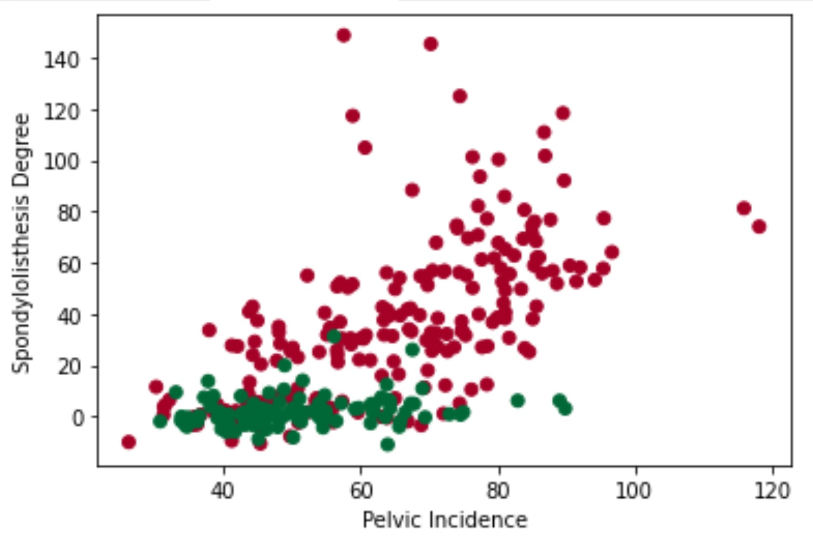
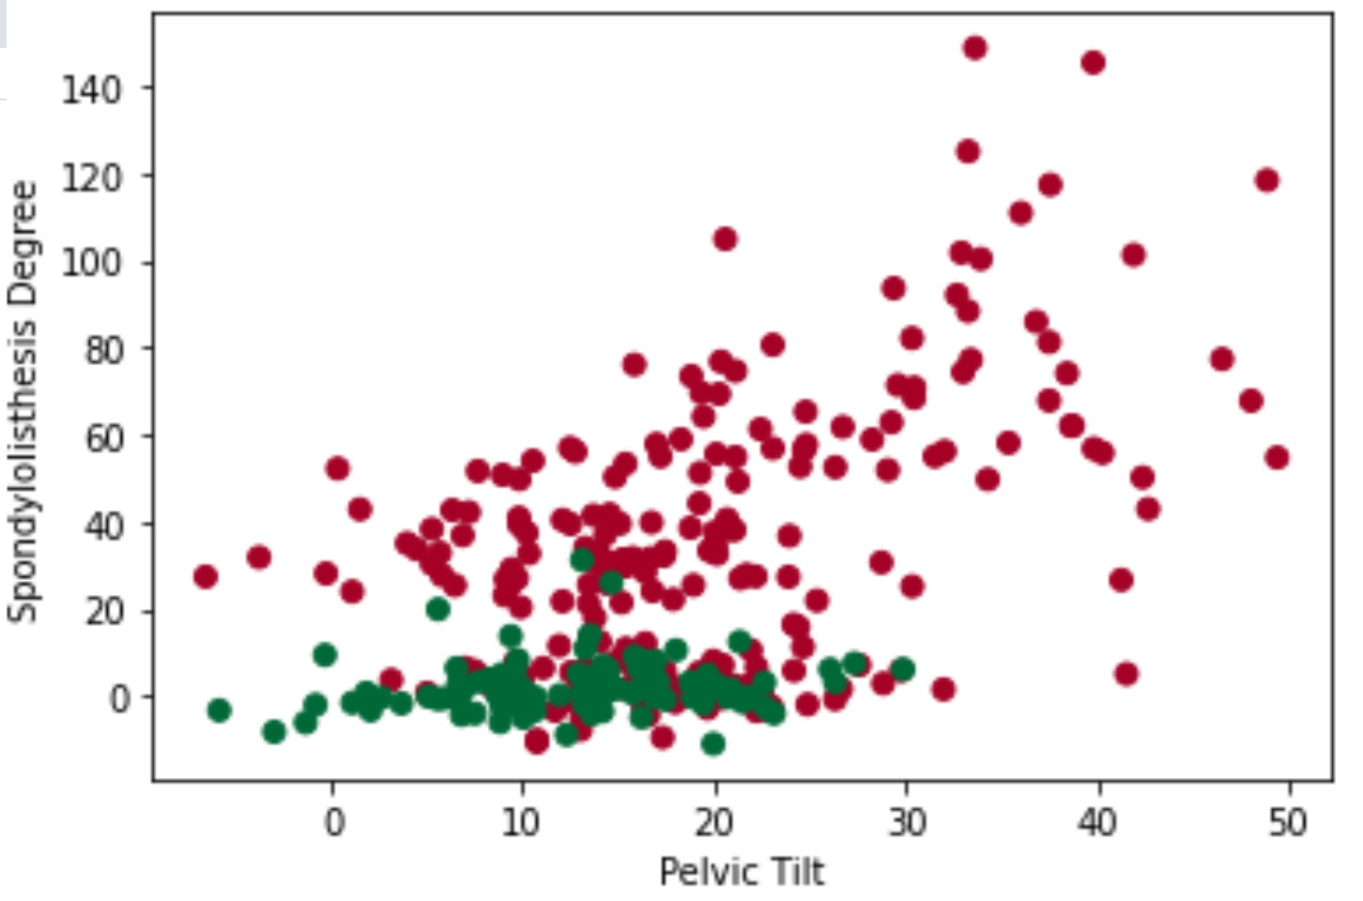
Scatter Plot

Slide 10
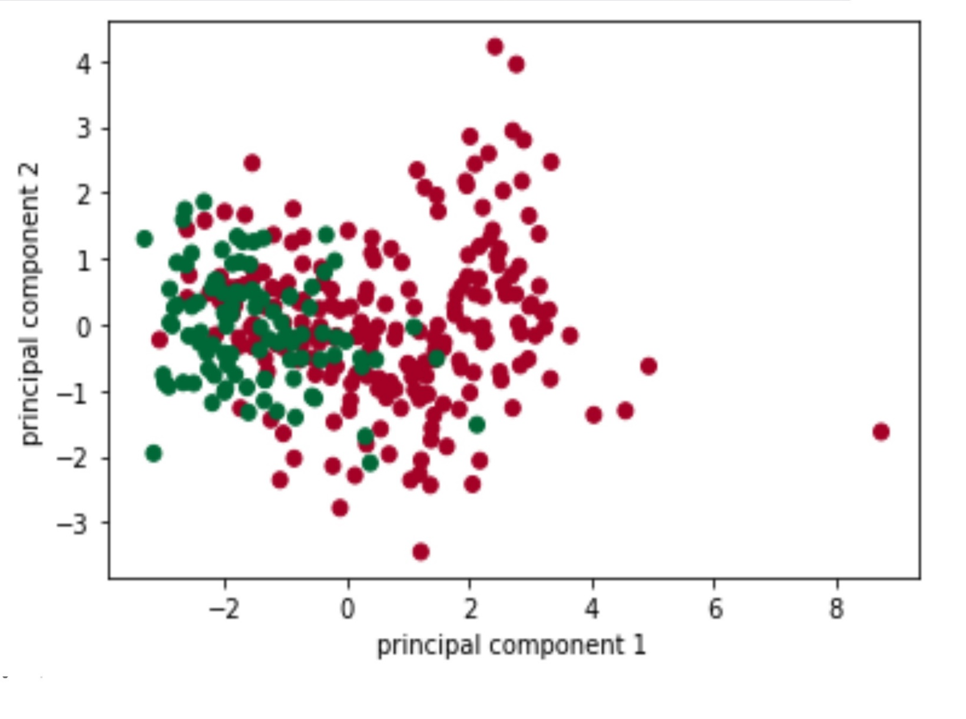
Principal Component Analysis
Standardize the range of continuous
initial variables
Compute the covariance matrix to identify correlations
Compute the eigenvectors and eigenvalues of the
covariance matrix to identify the principal components
Create a feature vector to decide which principal components to keep
Recast the data along the principal components axes

Slide 11
Possible ML methods?
Quantitative classification
Support Vector Machine
Logistic Regression

Slide 12
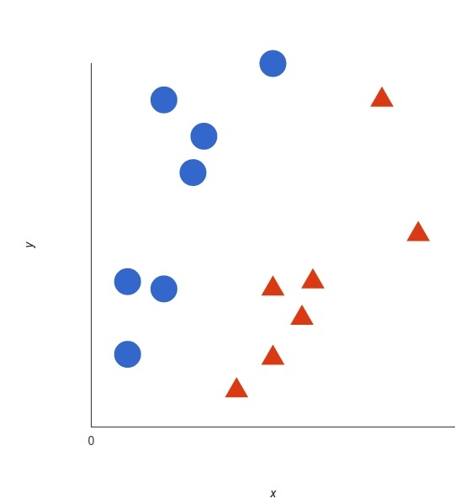
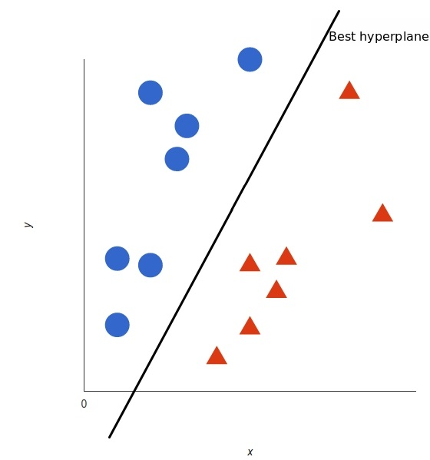
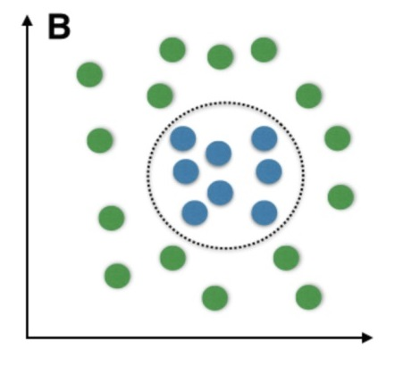
Implementing SVM
A supervised machine learning model that uses classification algorithm for two-group classification problems.
A fast and dependable classification algorithm that performs very well with a limited amount of data to analyze.

Slide 13
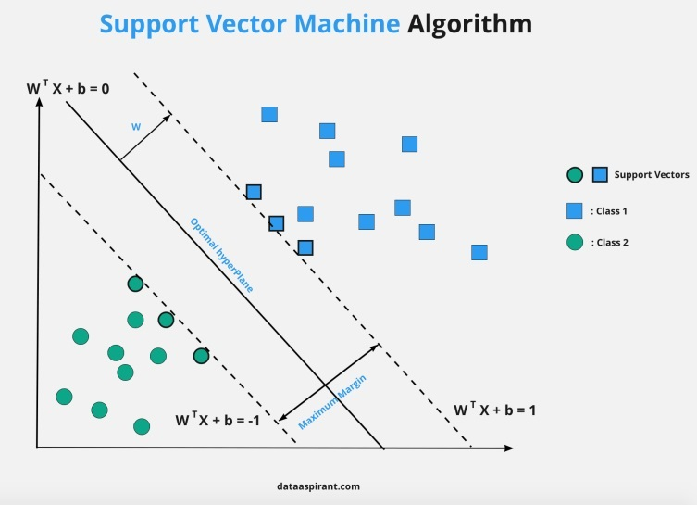
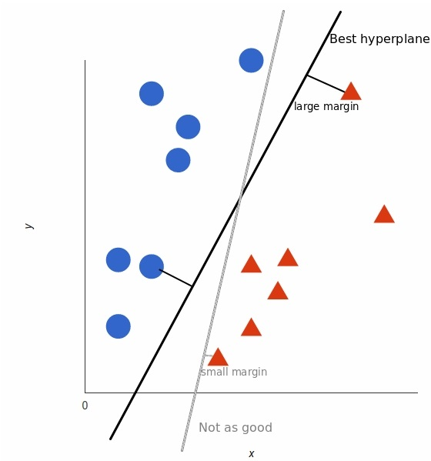
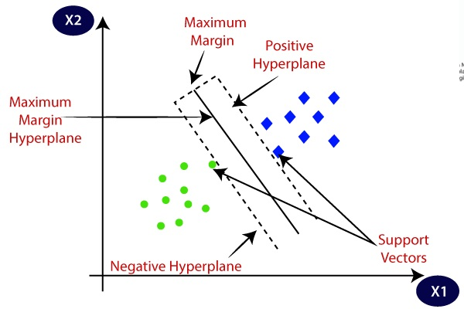
Maximum-margin hyperplane

Slide 14

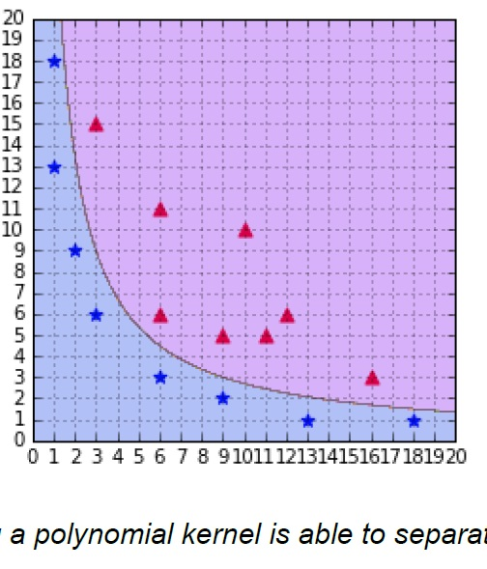
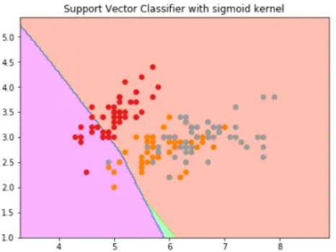
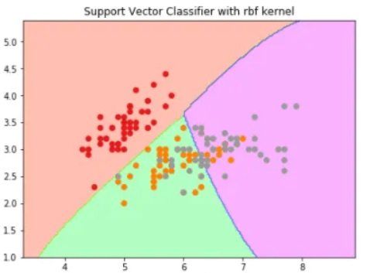
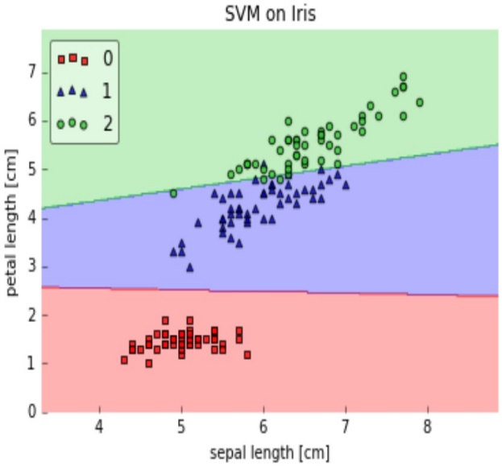
Kernels in Support Vector Machine

Slide 15
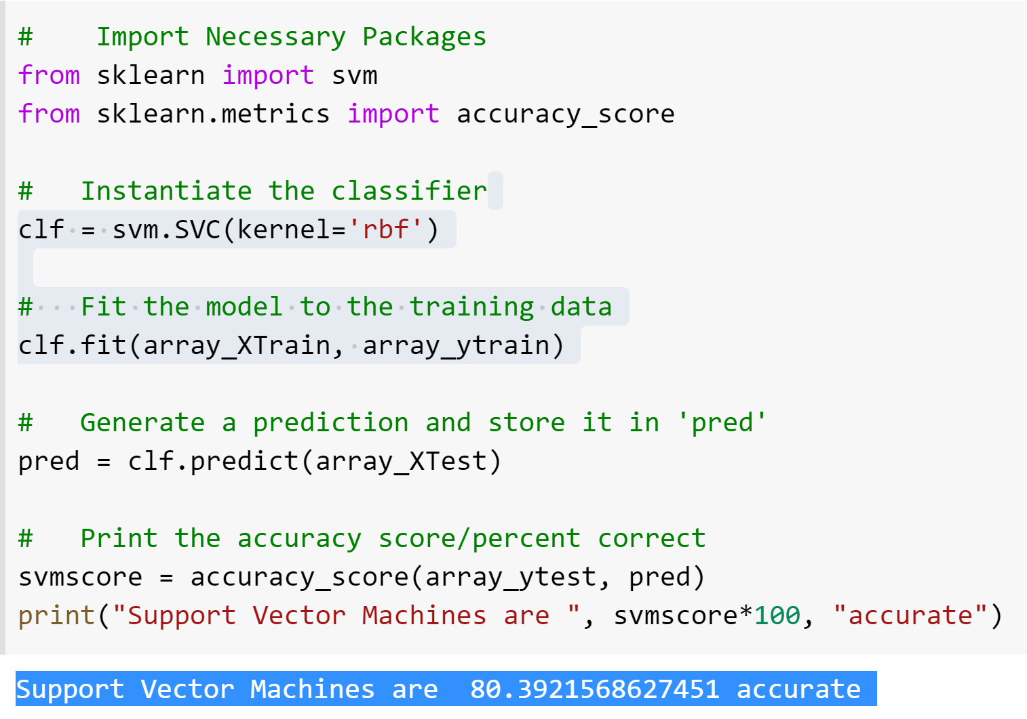
Running SVM with RBF kernel

Slide 16
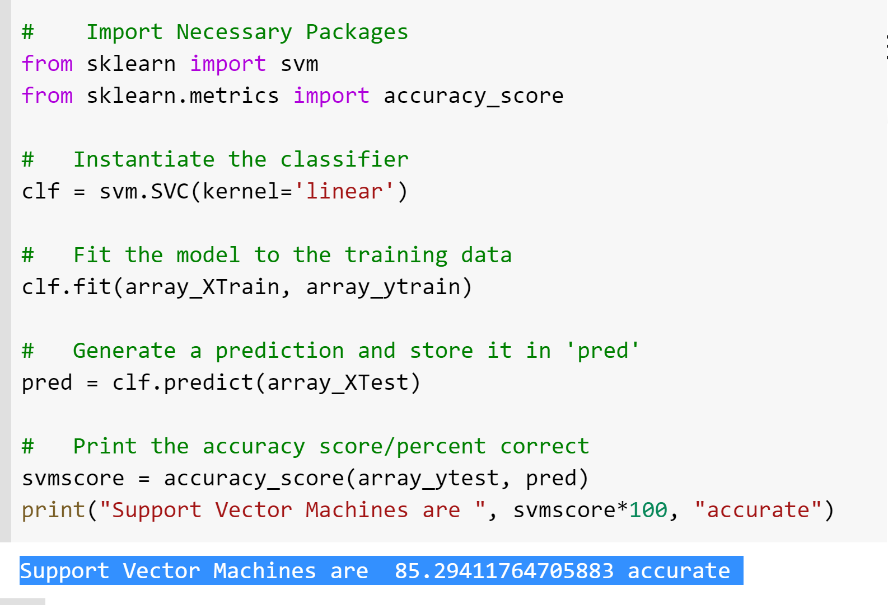
Running SVM with Linear kernel

Slide 17
SHAPLEY
We find the base contribution of each feature using SHAPLEY values by:
Calculating Shapley value
SHAP Feature importance plot
SHAP Summary Plot
SHAP Dependence Plot

Slide 18
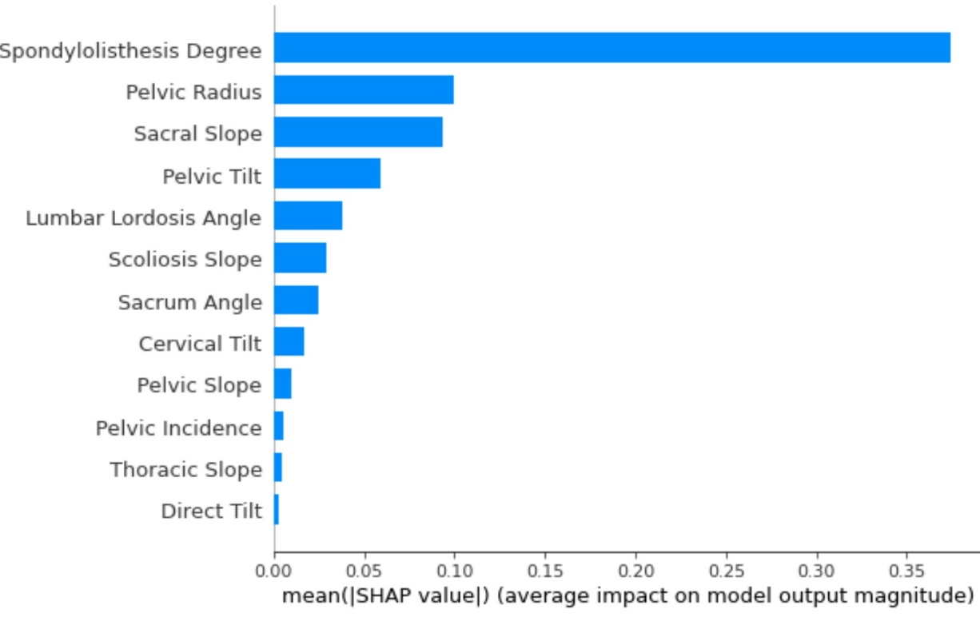
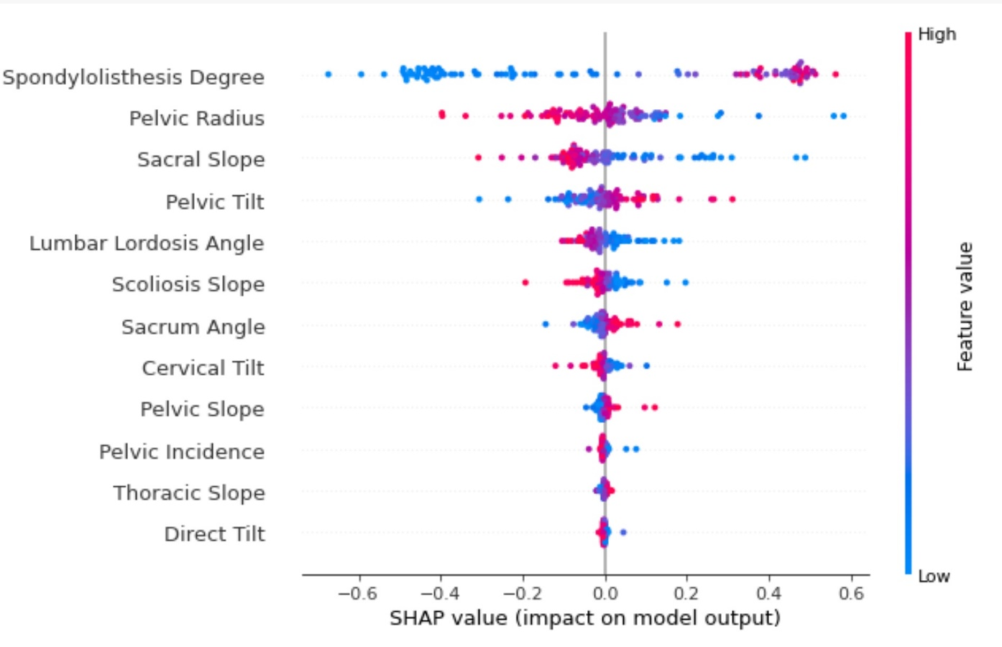
SHAPLEY values for our model

Slide 19
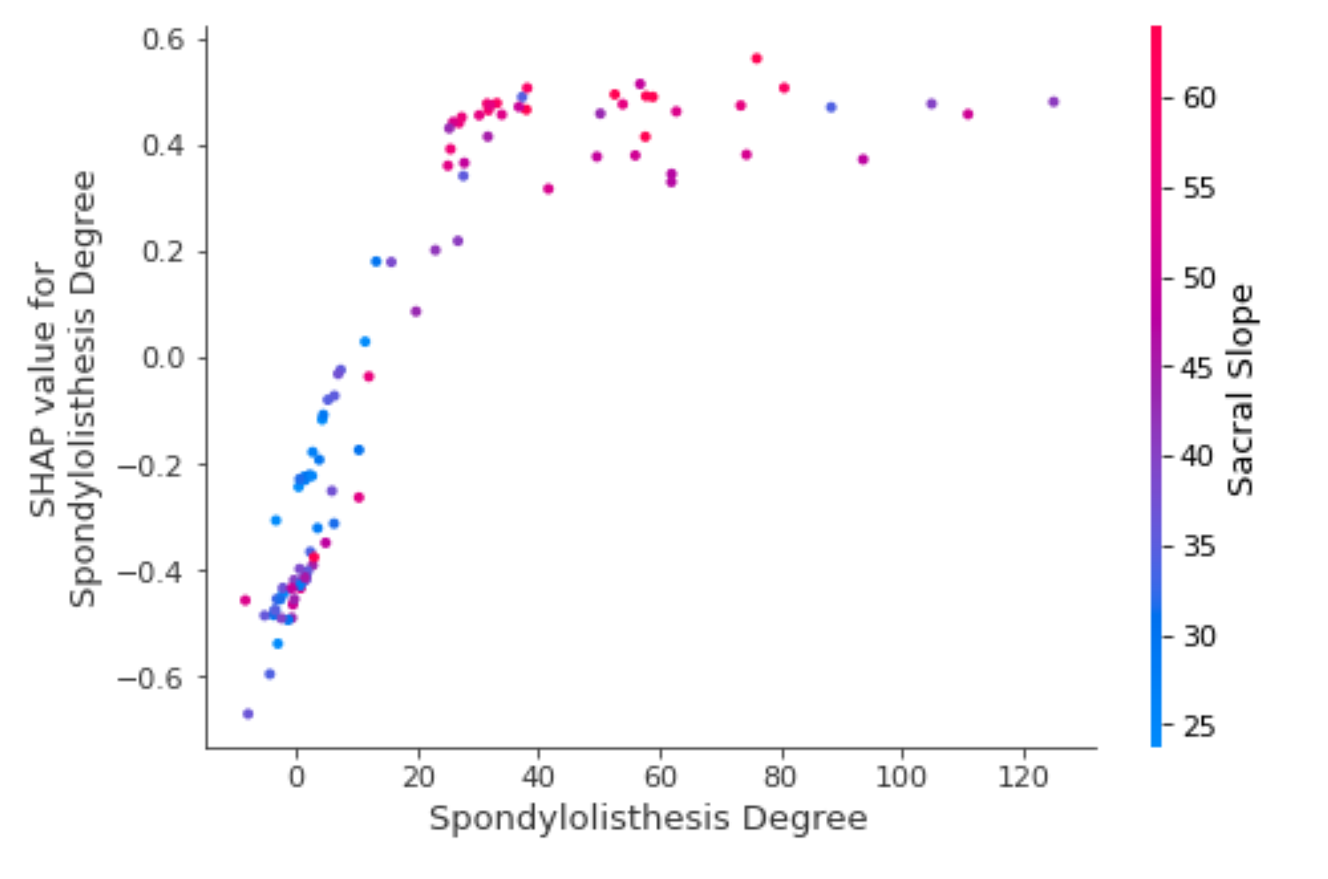
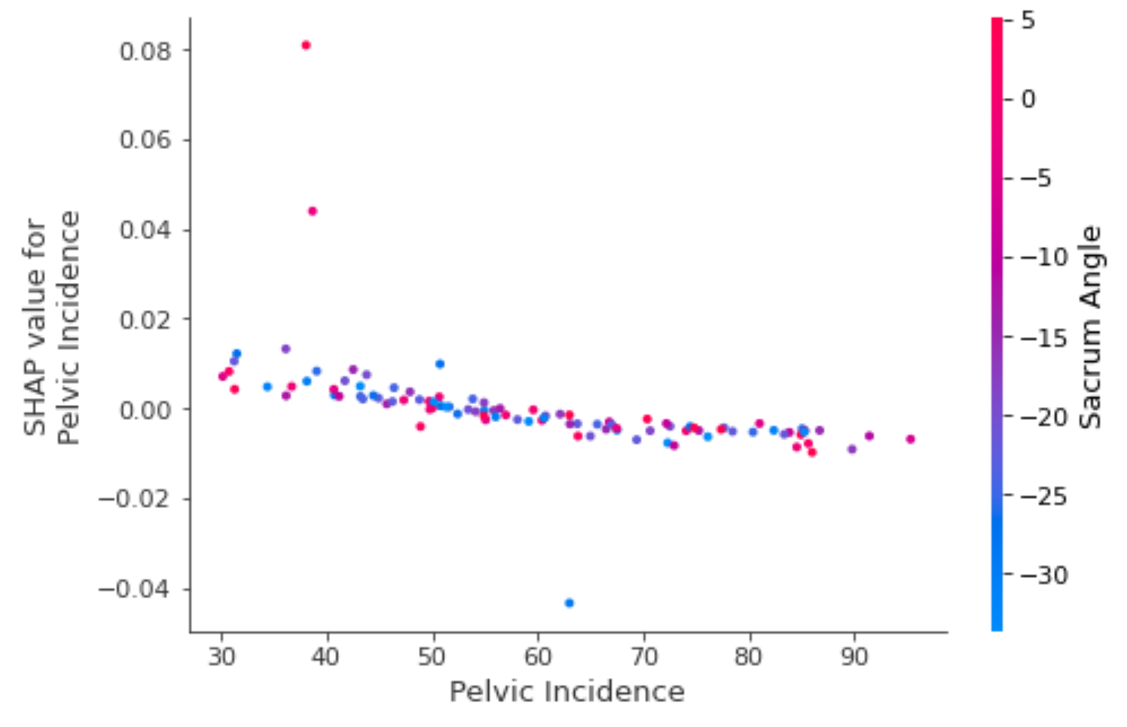
Monotonic Behavior

Slide 20
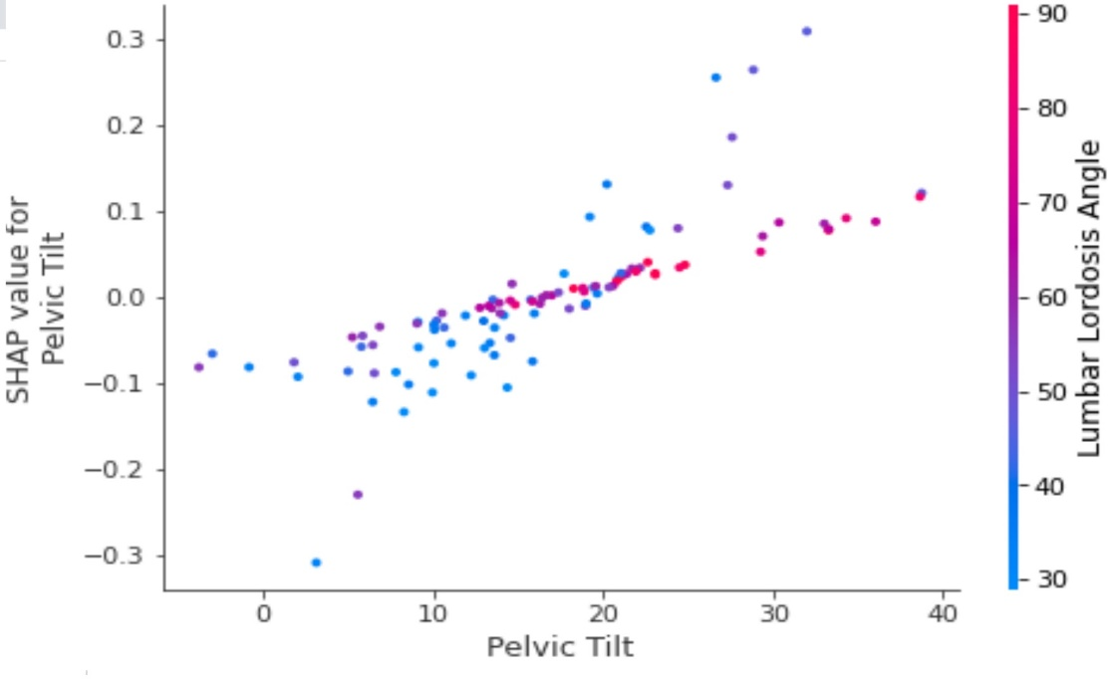
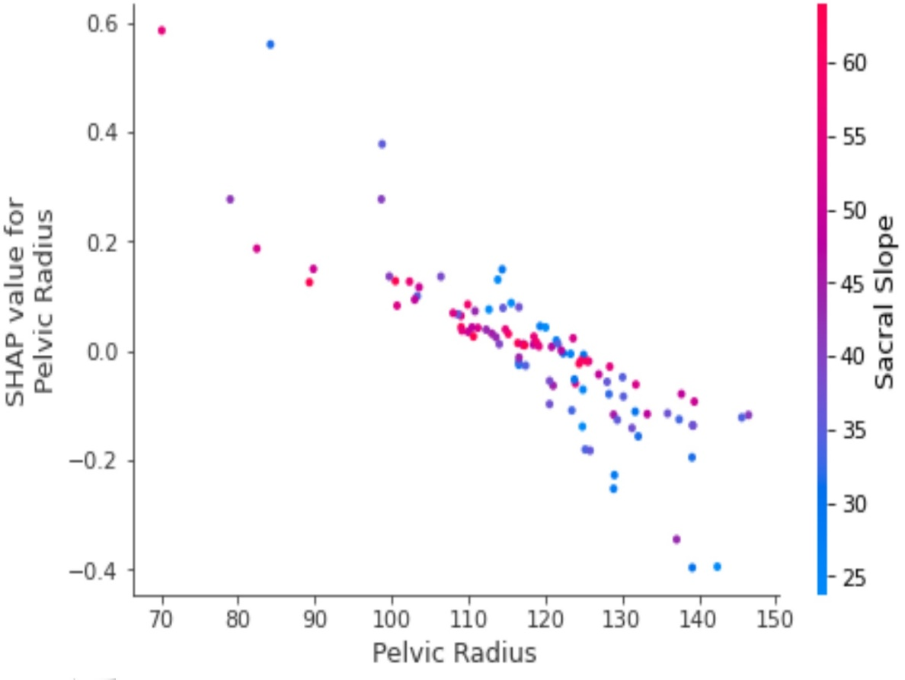
Monotonic but heterogeneous

Slide 21
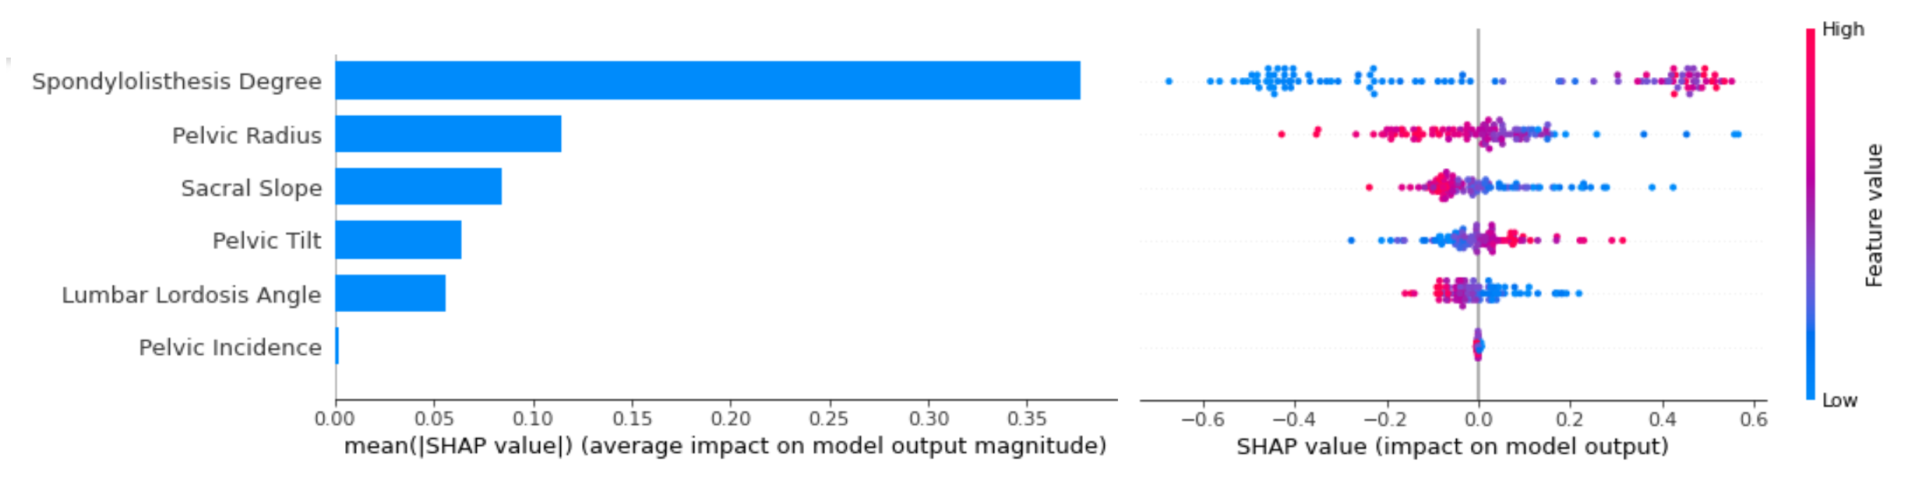
Suggestion 1
Selecting only the relevant features
What if we only consider the first 6 columns?
Using only first 6 parameters: Accuracy 85 88 !
A model with less features work better? More Is not Better?

Slide 22
Suggestion 2: Can we use SHAPLEY for feature extraction?
Define a new feature
to separate pelvic tilts with
different levels of Lumbar
lordosis angle
New Feature: pelvic tilt*
Lumbar lordosis angle

Slide 23
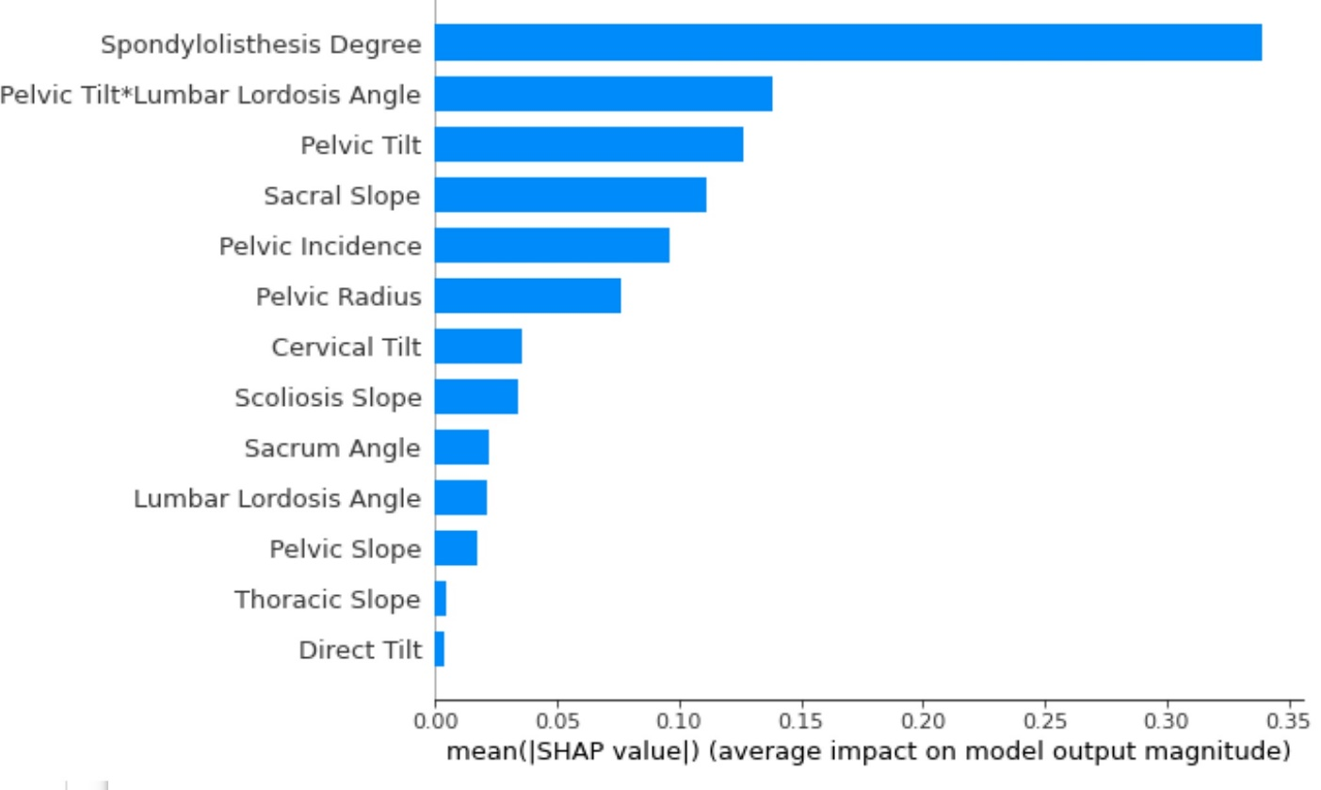
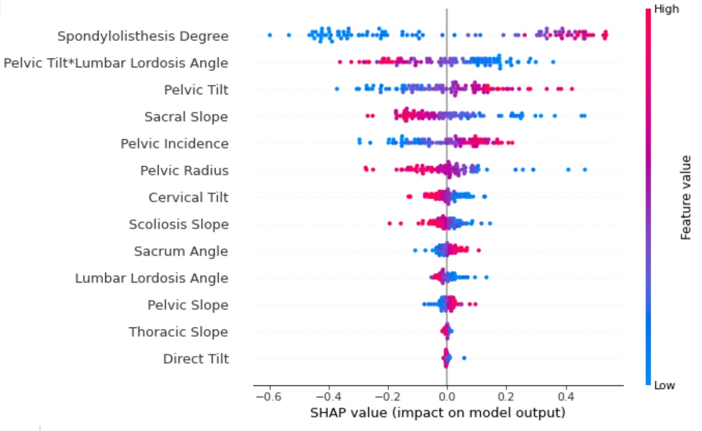
New Feature, does it helpe?
Accuracy 85 87 !

